Slide 1
CONTINUATION OF THE INTEGRATED VAAL RIVER SYSTEM RECONCILIATION STRATEGY STUDY – PHASE 2
Strategy Steering Committee Meeting 1
DWS Chair: L Mabuda
Chief Director: Integrated Water Resources Planning
Tuesday, 27 February 2018

Slide 2
Continuation of the Integrated Vaal River System Reconciliation Strategy Study: Phase2
Item 3: Acceptance of Agenda
Tuesday, 27 February 2018

Slide 3
AGENDA

Slide 4
AGENDA

Slide 5
Continuation of the Integrated Vaal River System Reconciliation Strategy Study: Phase2
Item 4: Purpose of the Meeting
Tuesday, 27 February 2018

Slide 6
Purpose of the meeting
  Introduce the study to all stakeholders
  Establish and define the role of the Strategy Steering Committee (SSC)
  Overview of study activities and water balance status
  Feedback on Strategy interventions
  Confirmation of SSC Membership

Slide 7
Continuation of the Integrated Vaal River System Reconciliation Strategy Study: Phase2
Item 5: Role of the Strategy
Steering Committee (SSC)
Tuesday, 27 February 2018

Slide 8
ROLE OF THE SSC
  Provide executive guidance to the direction and outcomes of the study
  Make available supplementary information and input from a local and regional perspective
  Facilitate strategic linkages with other initiatives
  Disseminate information from study into the relevant organisations
  Incorporate strategies’ recommendations into development plans such as IDPs etc;
  Ensure the implementation of the Strategy recommendations.

Slide 9
Continuation of the Integrated Vaal River System Reconciliation Strategy Study: Phase2
Item 6: Background and Introduction of the Study
Tuesday, 27 February 2018

Slide 10
Reconciliation Strategy - What is it?
  Plans of action or policy designed to ensure sufficient water is made available to towns over the next +-20 years.
  Uses existing information collected (building blocks) on:
    Water requirements
    Water use and infrastructure
    Water resources
    WC/WDM
  Develop scenarios to meet water requirements for current and future use, including optimisation of local resources, improved water services and water resource management.

Slide 11
Reconciliation Strategy - What is it?
  It aims to answer the following questions:
    How must water is needed? - now and in the future
    What water resources are available or can be made available?
    Which interventions can be consider to achieve a balance between water needs and supply?
  Focuses on the projected annual water balance.
  Also considers the accuracy of all the components that make up the water balance.

Slide 12
VAAL Water Resource Management History
1983 | Drought Analysis ( before systems & stochastic models )
1990 | Vaal River System Analysis
Since 1989 | Vaal River Annual Operating Analysis
1996 | Vaal Augmentation Planning Study ( VAPS )
2001 | Vaal River System Analysis Update Study ( VRSAU )
2001 | Thukela Water Project Feasibility Study
2003 | Thukela Water Project Decision Support Phase
2004 | Internal Strategic Perspectives (ISP)
2004 | Vaal River Eastern Subsystem Augmentation Project ( VRESAP )
2007 | Potential Savings Through WC/WDM in the Upper and Middle Vaal WMA
2009 | Vaal River System: Large Bulk Water Supply Reconciliation Strategy
2009 | Development of an Integrated Water Quality Management Plan for the Vaal River System
2010 | Comprehensive Reserve Determination: Integrated Vaal River System
2010 | Comparative Study Between LHWP Phase II And Thukela Water Project
2012 | Classification of Significant Water Resources ( WMA 8,9,10 )
2013 | Feasibility Study for the Long-Term Solution to address the AMD from the Eastern, Central & Western mining basins
2015 | Continuation of the IVRS Reconciliation Strategy Study ( Phase 1 )
2016 | Classes and Resource Quality Objectives of Water Resources for Catchments of the Upper, Middle and Lower Vaal
Current | This Study
Notes:
First column: Year in which study was completed.

Slide 13
Outcomes of previous assignment (2015)
  Options for reconciling increasing water requirements with the current supply in the Integrated Vaal River System:
      WC/WDM (Project 15%)
      Eradication of unlawful water use in the irrigation sector
      Desalination of mine water
      Re-use of water (Tshwane Project)
      Lesotho Highlands Water Project Phase 2

Slide 14
Why Continuation of a strategy? (this study)
  Water balances need to be continuously monitored / investigated and the strategy regularly updated to remain technically relevant.
  Ensures that intervention planning can be implemented taking into account any changes that may impact on the projected water balance.
  Study Objective: In-depth review, systematically update and improve the water resource reconciliation strategy so that it remains relevant, technically sound, economically viable, socially acceptable and sustainable and thus enabling the implementation of the strategy by the relevant authorities.

Slide 15
APPOINTED PSP
  The Professional Service Provider (PSP) appointed to undertake the study : Batatise Consulting Engineers in association with UWP Consulting Engineers and WRP Consulting Engineers (Joint Venture).
DWS Enquiries | Technical Enquiries
Seef Rademeyer Chief Engineer: NWRP (Central) Tel: (012) 336 7500 Email: rademeyerS@dws.gov.za | Leon de Jager Batatise/UWP/WRP Tel: (012) 424 9700 Email: leondj@uwp.co.za | Sibusiso Sithole Batatise/UWP/WRP Tel: 082 921 1600 Email: sibusisos@romh.co.za

Slide 16
CONTINUATION OF THE INTEGRATED VAAL RIVER SYSTEM RECONCILIATION STRATEGY STUDY – PHASE 2
Item 7: Overview of Study Activities
Tuesday, 27 February 2018

Slide 17
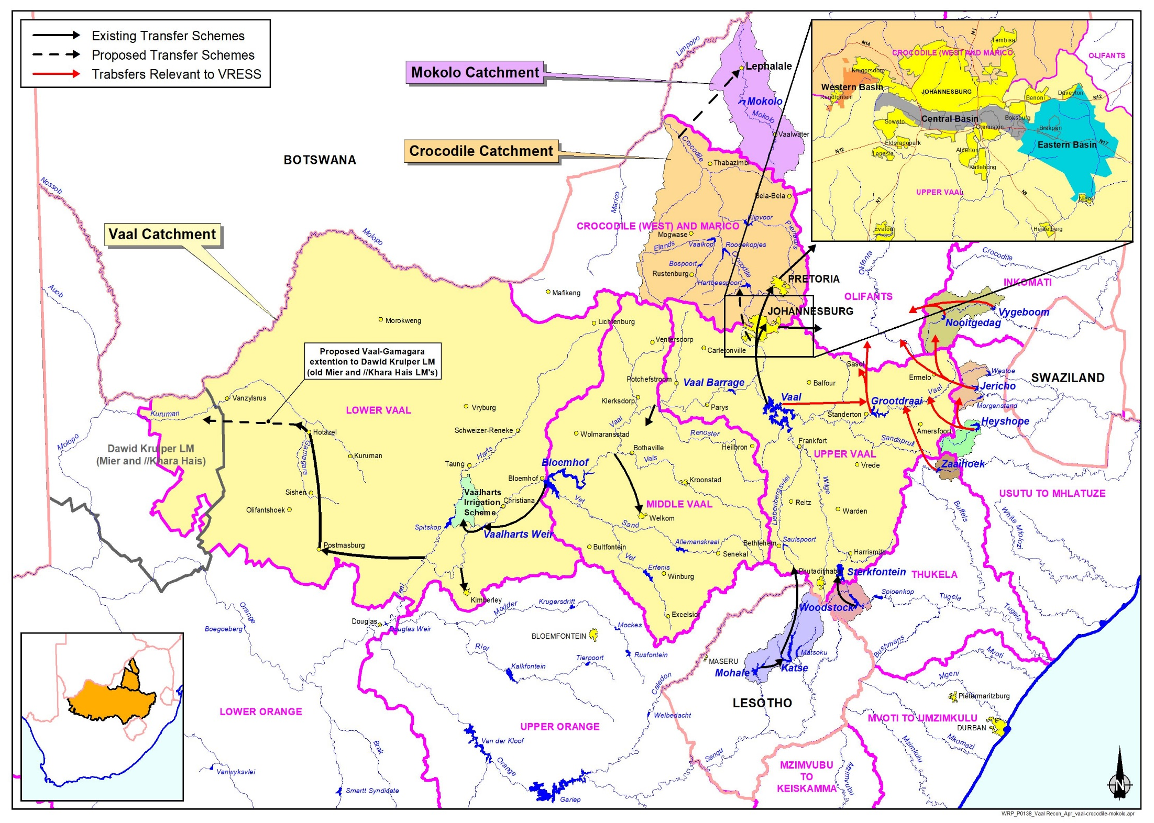
STUDY AREA

Slide 18
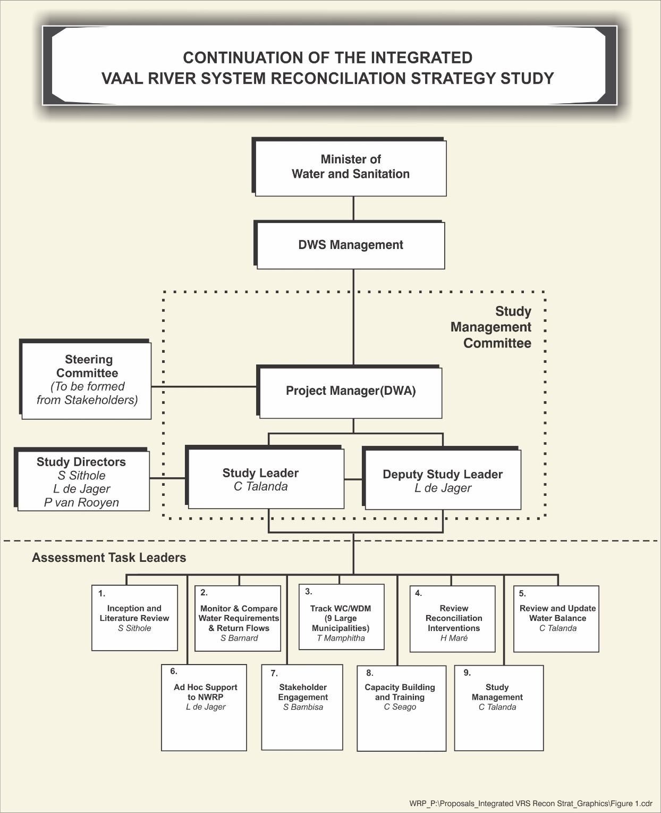

Slide 19
STUDY TASKS
TASK NUMBER | TASK DESCRIPTIONS
1 | Inception and literature review
2 | Monitor and compare water requirements and return flow
3 | Track Water Conservation and Water Demand Management
4 | Review reconciliation interventions: Bloemhof Dam excess utilisation investigation Acid Mine Drainage (AMD) management option implementation monitoring Evaluate the need to activate further planning of Thukela Water Project if required Implications of reduced operational capacity on sustainable yield Monitor/Track Progress: WCWDM, Eradication of unlawful irrigation, Implementation programme of LWHP Phase 2, Planning in the Crocodile (West) and Olifants River system that may influence this Reconciliation Strategy

Slide 20
STUDY TASKS
TASK NUMBER | TASK DESCRIPTIONS
5 | Review and update water balance
6 | Stakeholder engagement
7 | Capacity building and training
8 | Ad Hoc Support
9 | Study management

Slide 21
TASK1: INCEPTION
Finalisation/DWS Approval of the study tasks scope, work processes and programme
Finalise the composition of the Study Administration Committee (SAM), Technical Support Group (TSG) and the Strategy Steering Committee (SSC)
Review previous study reports and other available information documented since previous study - focus on aspects that influence study tasks and strategy actions.
Deliverables:
  Report: Inception Report

Slide 22
TASK 2: MONITOR AND COMPARE WATER REQUIREMENTS AND RETURN FLOWS
First Phase (1-12 months)
  Collate historical water use and return flow data for all the Sewage Drainage Areas for comparison
  Compile and compare recent demographic trends in the main urban centres with previous Strategy Scenarios
  Make recommendations on the need to undertake a comprehensive update of water requirement & return flow scenarios
  Evaluate April 2017 Eskom projections to substantiate (or not) the reductions in water use from 2019 onwards
  Asses DWS Validation and Verification process results

Slide 23
TASK 2: MONITOR AND COMPARE WATER REQUIREMENTS AND RETURN FLOWS
Second Phase (12-36 months)
  Monitoring use of bulk users (9 large municipalities monitored in the AOA) and identify any significant deviations that may influence the strategy
Deliverables:
  Worksheets and WRPM model input data
  Review of the Water Requirements and Return Flows will be discussed and presented in the SSC Status Reports

Slide 24
TASK 3: TRACK WCWDM
Activities will include:
  Status Quo Assessment (Update system water loss balance diagram, assess WCWDM implementation progress and review savings achieved to date)
  Assessment of results
  WSA feedback
Key demand centres include
City of Johannesburg City of Tshwane**
Ekurhuleni** Emfuleni**
Lesedi Midvaal
Randfontein** Mogale**
Westonaria Merafong
Rustenburg** Govan Mbeki**
Matjhabeng**

Slide 25
TASK 3: TRACK WCWDM
Deliverables:
  WCWDM status quo assessment of each WSA
  Informed decision makers on the progress made with the implementation of WCWDM in each WSA and actions required to ensure water security in the Integrated Vaal River WSS.

Slide 26
TASK 4: REVIEW RECONCILIATION INTERVENTIONS
Review and evaluate strategy reconciliation interventions and assess impact on the water balance
The following reconciliation interventions will be evaluated:
  Bloemhof Dam excess utilisation investigation
  Acid Mine Drainage (AMD) management option implementation monitoring
  Evaluate the need to activate further planning of Thukela Water Project if required
  Implications of reduced operational capacity on sustainable yield

Slide 27
TASK 4: REVIEW RECONCILIATION INTERVENTIONS
In addition to, progress will be tracked on the implementation of the other interventions namely:
  WCWDM
  Eradication of unlawful irrigation
  Implementation programme of LWHP Phase 2
  Planning in the Crocodile (West) and Olifants River system that may influence this Reconciliation Strategy
Deliverables:
  Worksheets and WRPM configuration data
  Review of Reconciliation Interventions will be discussed and presented in the SSC Status Reports

Slide 28
TASK 5: REVIEW AND UPDATE WATER BALANCE
Update projected annual water balance based on WRPM analyses (Task 4) for selected scenarios.
Undertake alternative scenario analysis with WRPM if required.
Undertake difference analysis to present the water balance implications of various future planning variables.
Deliverables:
  Worksheets and WRPM configuration data
  Review of Reconciliation Interventions will be discussed and presented in the SSC Status Reports

Slide 29
TASK 6: STAKEHOLDER ENGAGEMENT
To provide stakeholders with meaningful information to assist them in providing useful contributions so that they are a part of the process and its implementation.
Activities:
  Database of Interested and Affected
  Announce the project/Background Information Document
  Study Steering Committee Meetings
  Media Releases/Newsletters
  Web access
  Liaison with Water Forums
Deliverables:
  Announcement Letter Stakeholder Database
  Media releases/Newsletters Web access arrangements
  SSC Meetings (x6) Status Reports
Notes:
National government (e.g. DWS (including IUCMA), DMR, DAFF, DEA, Cogta).
Provincial government (Mpumalanga Premier’s office, MDARDLEA).
Local government (Ehlanzeni District Municipality and Mbombela Local Municipality).
Reference groups (e.g. WUAs, Irrigation Boards, Forestry SA, SANParks, existing forums).
Agriculture and farmers’ organisations (e.g. Agri-SA, co-operations).
Regional and local media (Lowvelder, Nelspruit Post, Mpumalanga News).
Business and commerce (Sappi).
Environmental bodies, both as authorities and NGOs.
Community representatives, CBOs, development bodies.

Slide 30
TASK 7: TRAINING/ CAPACITY BUILDING
Objectives is to capacitate DWS Staff and team members in specialist aspects relating to the IVRS Reconciliation Strategy.
Training and capacity building activates will be structured in the form of:
  Formal training
  Staff secondment in order for trainees to gain further hands-on experience in the technical processes and application of the models
Deliverables:
  Training Material
  Training Report

Slide 31
TASK 8: AD HOC SUPPORT
Ad hoc studies and/or investigations as may be required during the study in support of the strategy.

Slide 32
TASK 9: STUDY MANAGEMENT
General study management and administration activities
Deliverables:
  Study Administration Meetings (SAM) (12 meetings)
  Study Management Committee (SMC) Meetings (12 meetings)
  Strategy Steering Committee (SSC) Meetings (6 meetings)

Slide 33
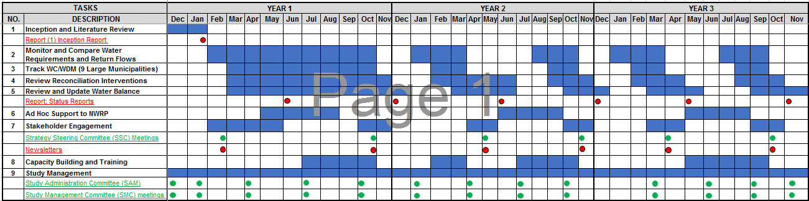
STUDY PROGRAMME

Slide 34
Continuation of the Integrated Vaal River System Reconciliation Strategy Study: Phase2
Item 8: Water Balance Status
Tuesday, 27 February 2018

Slide 35
Presentation Layout
Water balance status - SSC June 2015 recap
Revised information:
      Information from Annual Operating Analysis 2017:
        AMD Desalination date – January 2022
        High Water Requirement Scenarios - Rand Water
        Risk analysis of projected drought water restrictions
      Eskom water requirement projections - April 2017
      LHWP Phase 2 – transfer water by December 2025
Preliminary revised water balance
      Risk and difference analysis
35

Slide 36
Rand Water Supply Area Scenarios (2015)
Rand Water Projection
(October 2014)
Rand Water
(2003)
WC/WDM &
Tshwane Reuse
Historical Water Use
Dashed lines from January 2014 SSC
36

Slide 37
Water Requirements
(Net System Water Requirements)
High Water Requirements
Unlawful Removed
High Water Requirement Scenario
Water Conservation and Demand Management
Unlawful Removed
Re-use (Tshwane)
Dotted Lines = January 2014 Analysis
37
Notes:
This is the Net demand picture when we add all the other users
Explain

Slide 38
Water Balance (June 2015)
High with target WC/WDM | Desalination for urban use (from July 2018) | Unlawful removed | Re-use (Tshwane )
High water requirement
Unlawful removed
WC/WDM savings
Tshwane re-use
High water requirement
Unlawful removed
Short term availability due to current reservoir volumes
LHWP Phase II Yield
(Polihali Dam)
System
Yield
Yield increases due to desalination of mine water
Elevated risks without WC/WDM savings
First transfer from LHWP Phase II
38

Slide 39
Reconciliation Perspectives (2015)
The following are essential to maintain balance Until LHWP Phase 2 can deliver water:
Water Conservation & Water Demand Management
Eradication of Unlawful Use
Desalination and Re-use of Mine Water
Tshwane Re-use Project
39

Slide 40
Strategic Interventions (2015)
Eradication of unlawful water use by 2015.
Implementation of WC/WDM (project 15%) – achieve target savings by 2017.
Implement phase 2 of LHWP by 2023.
Mine water effluent treatment and use by 2018.
Tshwane water augmentation project (re-use).
Plan yield replacement scheme in Orange.
Manage uncertainties: Vaal, Crocodile and Olifants.
Implementation of integrated water quality management plan.
40

Slide 41
Preliminary revised water balance
(February 2018)

Slide 42
Rand water demand projections for 2017/2018 AOA
High Water Requirement
Scenario
June 2015
Projection scenarios
Reduction in water use due to restrictions

Slide 43
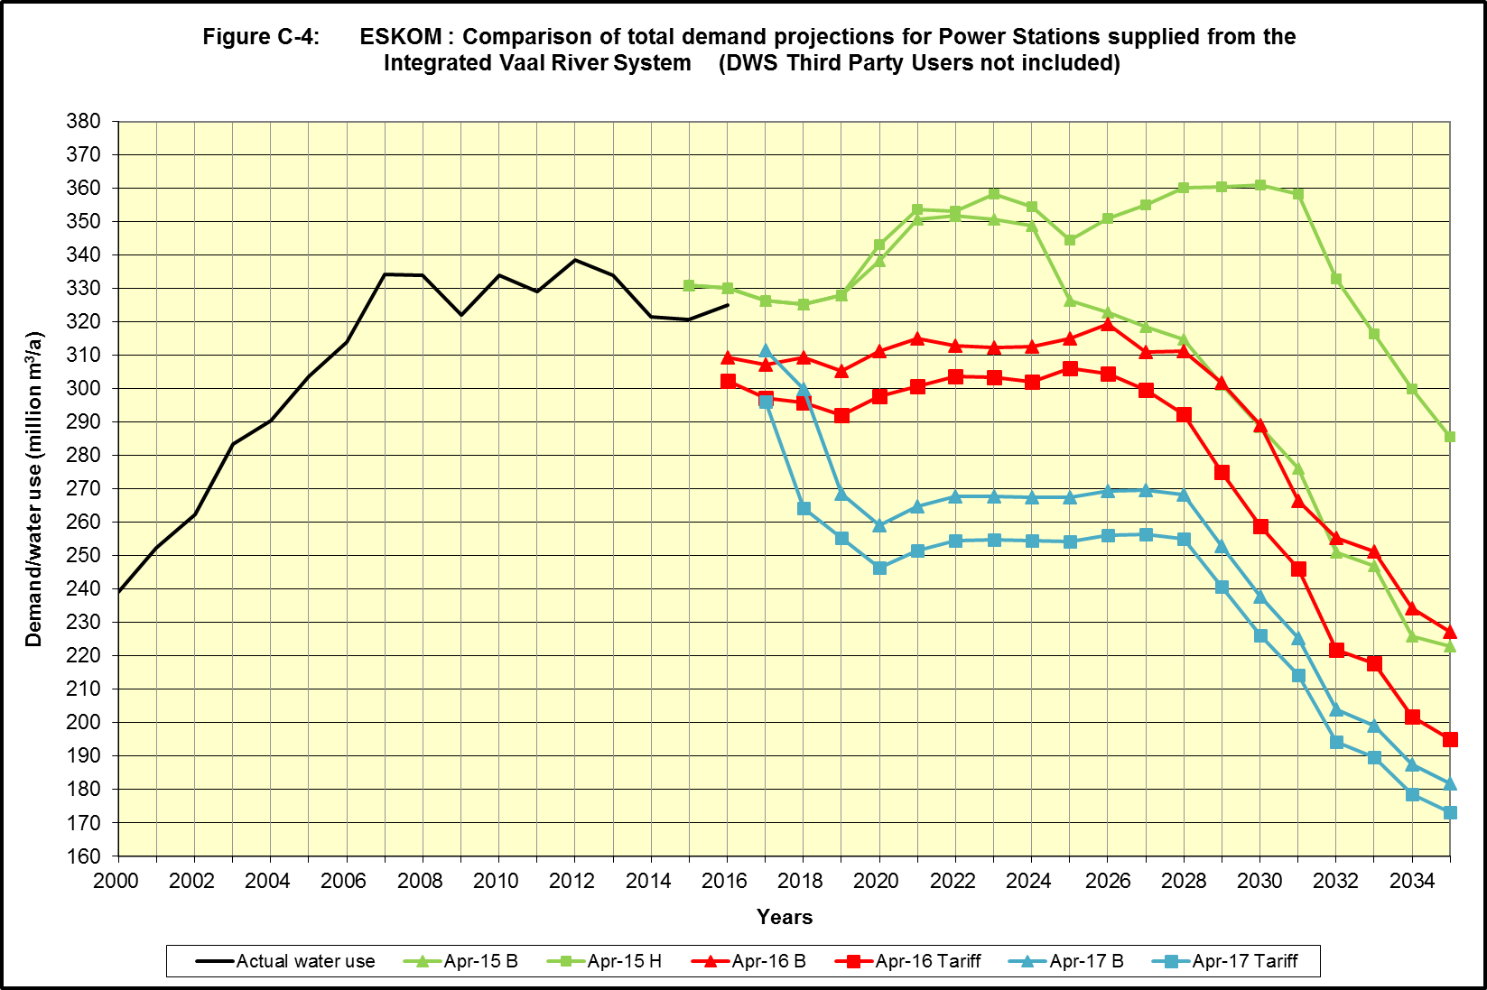
Eskom (Total for Integrated Vaal River System)
(April 2017 projection)
180 million m3/a
Reduction
Desalination of AMD January 2022

Slide 44
Water Requirements (2015)
(Net System Water Requirements)
High Water Requirements
Unlawful Removed
High Water Requirement Scenario
Water Conservation and Demand Management
Unlawful Removed
Re-use (Tshwane)
Dotted Lines = June 2015 Analysis
44
Notes:
This is the Net demand picture when we add all the other users
Explain

Slide 45
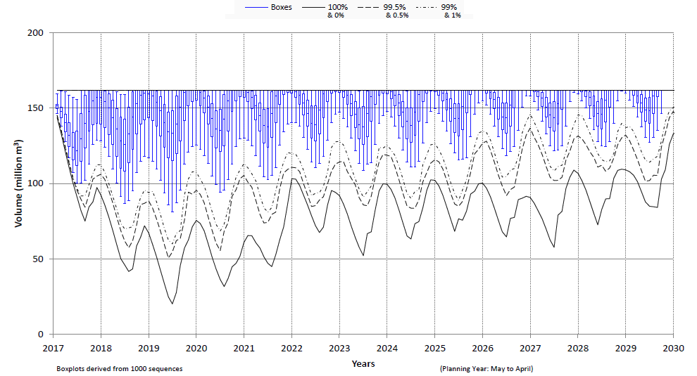
Storage Projection of the Komati System
(Risk analysis AOA June 2017)
Vygeboom and Nooitgedacht reservoirs
Unutilised Storage due to reduction in Eskom water requirements
Unutilised Yield @ (1:100 RI)
36 | 38 | 39 | 37 | 40 | 44 | 48 | 49 | 53 | 59 | 65

Slide 46
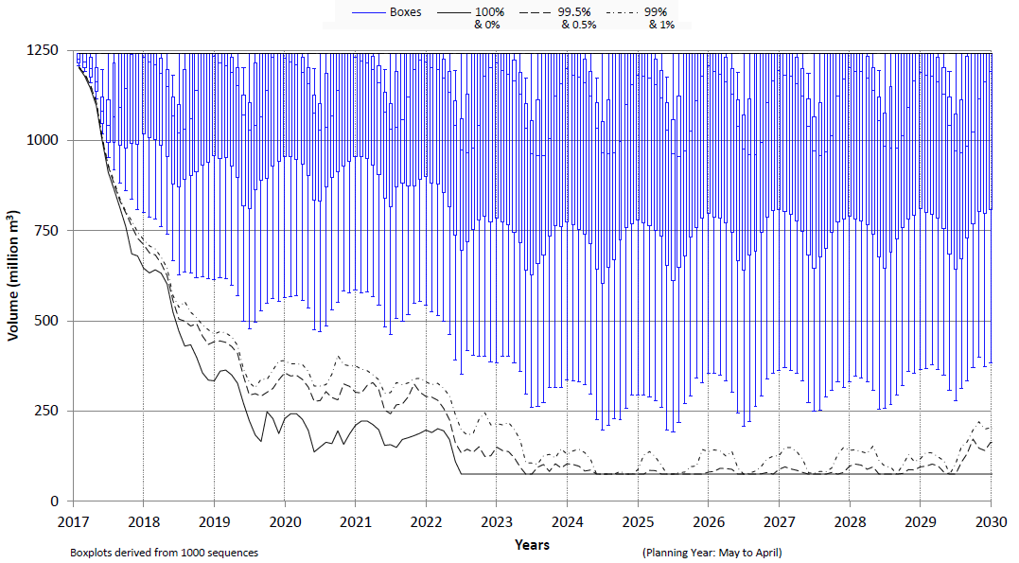
Storage Projection Bloemhof Dam
(Risk analysis AOA June 2017)
Unutilised storage due to dilution releases from Vaal Dam and return flows
DSV
Desalination of AMD January 2022

Slide 47
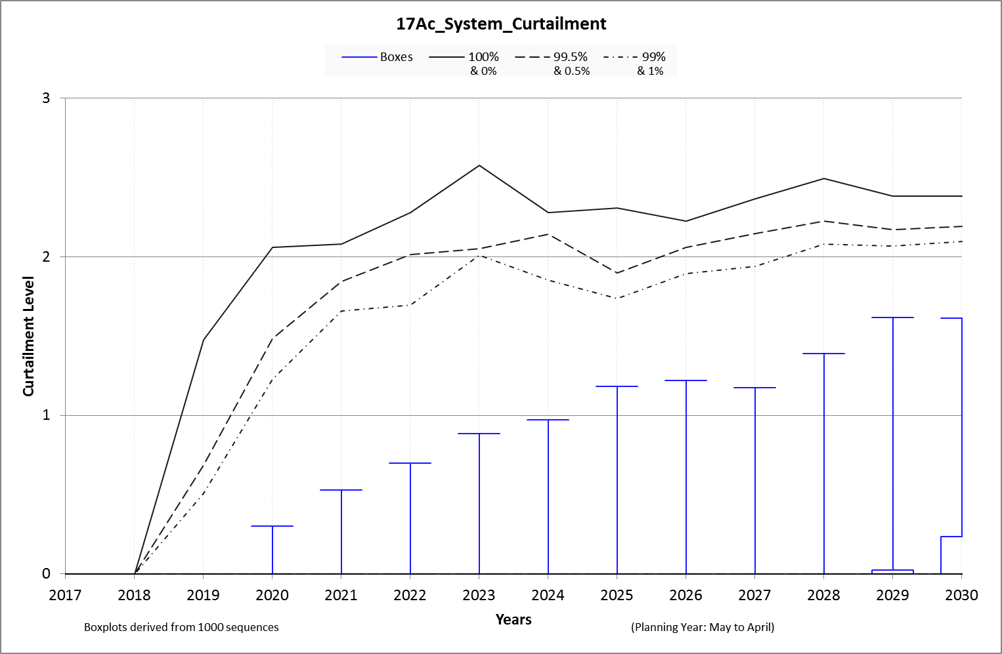
Risk of Drought Restrictions
(NB: Needs adjustments for unused storage in Komati and Bloemhof dams)
High Demand Scenario
Desalination Jan-2022
LHWP not implemented
By 2024 Level 1 Curtailment occurs at 5% risk:
50% Irrigation Curtailment
30% Urban Curtailment
Violation of Risk Criteria
0.5 %
min %
1 %
Min %
0.5 %
1.0 %
5.0 %
25 %
50 %
75 %
95 %
99 %
99.5 %
Max %
5 %

Slide 48
Preliminary Water Balance (February 2018)
High with target WC/WDM | Desalination for urban use (from January 2022) | Unlawful removed | Re-use (Tshwane )
High water requirement
Unlawful removed
High water requirement
Unlawful removed
WC/WDM savings
Tshwane re-use
Earliest Date for Yield
Replacement (2030)
System
Yield
Polihali Dam Net Yield
Polihali Dam Yield
Yield increases due to desalination of mine water
Elevated risk of restrictions.
Violation of risk criteria.
Elevated risks without WC/WDM savings
First transfer from LHWP Phase II – Dec 2025
48
Notes:
System yield accounts for:
Reduction due to excessive dilution prior to desalination of AMD.
Unused storage (yield) in Komati River System.

Slide 49
Observations
Reduction in system yield due to:
      Excessive dilution releases from Vaal Dam until desalination of AMD (January 2022.)
      Unused yield in Komati Subsystem due to reduction in Eskom power station water requirements.
Elevated risks of restrictions prior to implementation of LHWP Phase 2.
      High Water Requirement Scenario exceeds risk criteria throughout the planning period.
      Further augmentation needed by 2043 - High Water Requirement Scenario with WC\WDM savings
49

Slide 50
Reconciliation Perspectives (2015)
Water Conservation & Water Demand Management, Eradication of Unlawful Use, Desalination and Re-use of Mine Water as well as Tshwane Re-use Project are all essential to reduce the risk of restrictions Until LHWP Phase 2 can deliver water.
Prepare for augmentation from the Thukela Water Project.
      Revive Feasibility Study
50

Slide 51
Activities
Update irrigation water use with current V&V information.
Review yield capability of Thukela Water Project.
Track progress of interventions:
      Implementation of LHWP Phase 2.
      Mine water effluent treatment.
      Tshwane water augmentation project (re-use).
      WC/WDM savings.
Plan yield replacement scheme in Orange.
Integration with Crocodile (west) and Olifants reconciliation interventions.
Implement integrated water quality management plan.
51

Slide 52
Continuation of the Integrated Vaal River System Reconciliation Strategy Study: Phase2
Item 9: Strategy Interventions
Tuesday, 27 February 2018

Slide 53
9.1: Water Conservation / Water Demand Management

Slide 54
Background
Baseline study completed in 2004/2005
An estimated 196 million m³ or 15% could be saved over a period of 10 years
Average consumption was expected to reduce from 330 ℓ/c/d to 290 ℓ/c/d
The four biggest municipalities were expected to contribute 94.3% of the total saving
The targets set in 2005 were revised in 2010 and 2012

Slide 55
Expected Savings per Municipality
Area | 2008/09 Annual Demand (million m³/a) | Current Non-Revenue Water (million m³/a) | 2005/06 Possible Savings (million m³/a) | % Contribution of total saving | % Reduction
City of Johannesburg | 502.7 | 160.9 | 110.2 | 56.2% | 21.9%
Ekurhuleni | 326.8 | 124.2 | 28.3 | 14.4% | 8.6%
City of Tshwane | 214.2 | 62.1 | 20.4 | 10.4% | 9.5%
Emfuleni | 77.1 | 31.6 | 26.1 | 13.3% | 33.9%
Rustenburg | 27.9 | 9.8 | 3.0 | 1.5% | 10.6%
Mogale | 26.4 | 7.1 | 1.7 | 0.9% | 6.6%
Govan Mbeki | 20.4 | 5.9 | 1.5 | 0.8% | 7.5%
Matjhabeng | 18.9 | 6.6 | 4.3 | 2.2% | 22.9%
Randfontein | 8.7 | 2.6 | 0.4 | 0.2% | 4.1%
Total | 1 223.0 | 410.8 | 195.9 | 100% | 16%

Slide 56
Summary of Data Submissions
Municipality | Last submission
City of Johannesburg | November 2016
City of Tshwane | April 2017
Emfuleni LM | June 2017
Ekurhuleni MM | November 2017
Lesedi LM | April 2017
Merafong LM | June 2017
Midvaal LM | October 2017
Mogale City LM | December 2016
Rand West City LM (Randfontein Region) | June 2017
Rand West City LM (Westonaria Region) | November 2017

Slide 57
Integrated Vaal River System
15% Water restrictions 12 Aug 2016 to 13 March 2017
Target
Target

Slide 58
Total Targeted vs Actual Savings
Year ending | Projected SIV without WDM (X) kl/annum | Projected SIV with WDM (Z) kl/annum | Projected % savings (X – Z) / X * 100 | Actual demand (Y) kl/annum | Actual % savings (X - Y) / X * 100
Jun-12 | 1 300 613 343 | 1 300 613 343 | 0.0% | 1 296 073 215 | 0.3%
Jun-13 | 1 325 208 539 | 1 273 402 875 | 3.9% | 1 337 536 245 | -0.9%
Jun-14 | 1 350 262 570 | 1 268 011 188 | 6.1% | 1 365 380 179 | -1.1%
Jun-15 | 1 375 784 167 | 1 262 935 804 | 8.2% | 1 403 523 126 | -2.0%
Dec-15 | 1 388 841 060 | 1 261 797 859 | 9.1% | 1 420 101 889 | -2.3%
Jun-16 | 1 401 897 953 | 1 260 659 914 | 10.1% | 1 413 031 287 | -0.8%
Dec-16 | 1 414 954 845 | 1 259 521 968 | 11.0% | 1 374 064 291 | 2.9%
Jun-17 | 1 424 217 581 | 1 261 854 997 | 11.4%
Jun-22 | 1 554 334 603 | 1 373 114 426 | 11.7%

Slide 59
Dec 2016 Summary of Targeted vs Actual Savings
System | Projected SIV without WDM (X) kl/annum | Projected SIV with WDM (Z) kl/annum | Projected % savings (X – Z) / X * 100 | Actual demand (Y) kl/annum | Actual % savings (X - Y) / X * 100
Johannesburg | 588 066 982 | 493 829 325 | 16.0% | 573 852 765 | 2.4%
Tshwane | 341 884 714 | 327 517 148 | 4.2% | 332 387 892 | 2.8%
Ekurhuleni | 369 315 955 | 346 720 055 | 6.1% | 352 297 242 | 4.6%
Emfuleni | 93 946 677 | 70 942 157 | 24.5% | 95 965 374 | -2.1%
Midvaal | 14 756 008 | 13 853 121 | 6.1% | 12 639 915 | 14.3%
Lesedi | 6 984 510 | 6 660 163 | 4.6% | 6 921 103 | 0.9%
Mogale City* | 29 553 459 | 27 943 452 | 5.4% | 33 408 509 | -13.0%
Randfontein* | 9 903 720 | 9 589 349 | 3.2% | 9 668 710 | 2.4%
Westonaria* | 7 192 187 | 6 460 157 | 10.2% | 0
Merafong City* | 13 324 128 | 12 056 011 | 9.5% | 13 476 658 | -1.1%
Total | 1 474 928 340 | 1 315 570 936 | 10.8% | 1 430 618 168 | 3.0%
*Total excl West Rand DM | 1 414 954 845 | 1 259 521 968 | 11.0% | 1 374 064 291 | 2.9%

Slide 60
2016 IVRS Water Balance
65.0%
28.3%
35.0%

Slide 61
IVRS litres/capita/day

Slide 62
Conclusions
Updated water balance information required to assess the status quo.
It is expected that the demand returned to previous levels once the water restrictions were lifted
It is unlikely that municipalities in the IVRS have been able to reduce their consumption by 112 million m³/a or 9% to achieve the 2017 target
Most municipalities are tracking the High demand – no WCWDM scenario

Slide 63
9.2: Rand Water Project 1600

Slide 64
9.3: City of Tshwane Water Resources Master Plan Implementation

Slide 65
9.4: Eradication of Unlawful Irrigation

Slide 66
9.5: Implementation of Infrastructural Augmentation Option (LHWP Ph2)

Slide 67
PROJECT MANAGEMENT UNIT (PMU)
The following project management activities are on-going:
Procurement activities for consultancy services contracts.
Procurement activities for the construction contracts.
Contract administration of all awarded contracts in Phase II.

Slide 68
Procurement Summary
Phase II Procurement Status (December 2017):
13 contracts, mostly designs and Environmental & Social studies are complete.
23 Contracts have been awarded and are in force. Of significance are the dam and tunnel consultancy contracts
10 contracts are in evaluation and approval stages.
No contracts are at the bidding/tendering stage.

Slide 69
Procurement Summary
Bids for the first 3 construction contracts (North East Access Road, Polihali Village civil works and the Polihali Dam Diversion Tunnel around the dam wall) currently under evaluation –awarded by end March 2018.
Geotechnical drilling (investigations for the Polihali Dam and Polihali – Katse Tunnel) at an advance stage. Will be complete in time for the Dam design and Tunnel design consultants to factor into the designs.

Slide 70
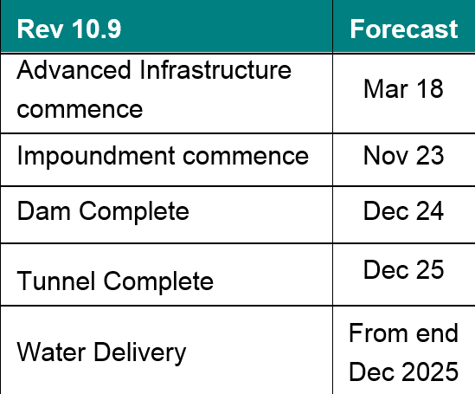
Procurement Millstones

Slide 71
9.6: Implementation of the AMD Long-Term Solution

Slide 72
1. Progress with LTS Commissioning
PSP for designing/ optimising the STI into an LTS (i.e. Desalination) has been identified following an open bidding process; and
TCTA to consider identified PSPs before end February 2018 and ratify decision on appointment.

Slide 73
2. Progress with EIA
EIA Practitioner (Nemai Consulting) appointed in Sep 2017;
Nemai Consulting, DWS and TCTA met with DEA in Nov 2017 to discuss project and map way forward; and
Formal application for LTS EIA dependent on project designs being available (hence LTS design PSP should be appointed a.s.a.p.).

Slide 74
3. Funding Options
Funding still via fiscus with 1/3 recovery form Vaal River Tariff; and
Future funding stream could be revenue generated from sale of desalinated AMD to bulk water user, environmental levy and/or WDCS.

Slide 75
4. Potential Off-takers
Engagements with potential bulk off-takers such as Ekurhuleni and City of Jo’burg, as well as Sasol is on-going;
Aside from economic issues, the actual determination of suitable off-taker will be guided by project design and optimisation (further motivating that LTS design PSP should be appointed a.s.a.p.);
No significant deviations from LTS Feasibility Study fundamentals anticipated; and
arget commission date for the LTS is Oct-Nov 2020.

Slide 76
9.7: Noordoever/Vioolsdrift Dam Feasibility Study

Slide 77
Continuation of the Integrated Vaal River System Reconciliation Strategy Study: Phase2
Item 10: Discussion and Comments
Tuesday, 27 February 2018

Slide 78
Continuation of the Integrated Vaal River System Reconciliation Strategy Study: Phase2
Item 11: Communication and confirmation of SSC membership
Tuesday, 27 February 2018

Slide 79
Communication
A SSC meeting will be held ~ 6 months
After each meeting SSC members will be provided with:
    Minutes of the SSC meeting
    Status Report
    Media release
    As members of the SSC your responsibility is to:
    Disseminate information into the relevant departments / organisations
    Incorporate strategies’ recommendations into development plans
    Web site: Please visit: http://www.dwa.gov.za/projects.aspx for all project related information
79

Slide 80
SSC membership
~ 270 stakeholders on the database
Representative of all relevant sectors in the study area – refer to Terms of Reference
80

Slide 81
Continuation of the Integrated Vaal River System Reconciliation Strategy Study: Phase2
Item 12: Date of Next Meeting
Tuesday, 27 February 2018

Slide 82
Continuation of the Integrated Vaal River System Reconciliation Strategy Study: Phase2
Item 13: Way Forward and Closure
Tuesday, 27 February 2018

